Slide 1
Expanded Geometry
There are 2 vectors contribute to the expanded vector
Expanded vector

Slide 2
Multi-agent path planning has been shown to be a PSPACE-hard problem

Slide 3
Cooperative Pathfinding
1. Using RRA* compute a abstract map for the purpose of getting accurate heuristic of N expanded nodes(nodes in closed table).
2. Using CA* (forward A* with other agents simultaneously by consulting the reservation table) to compute the solution for mutli-agent pathfinding.
3. If the agent can’t find a solution within the expanded nodes, the RRA* will be resumed and expanded more nodes until reach goal.

Slide 4
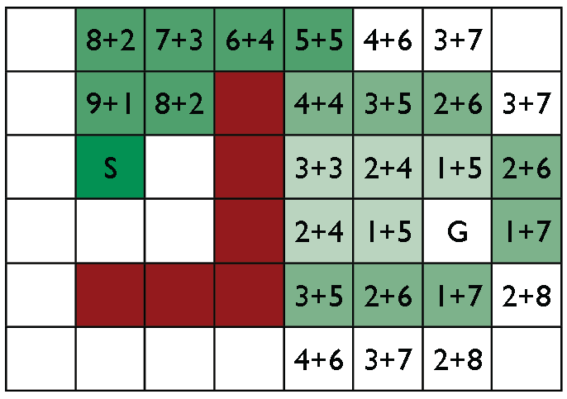
Using RRA* to expand N nodes from goal to initial position
This is called abstract map, because you do the RRA* but ignore the time dimension and the interaction with other agent.

Slide 5
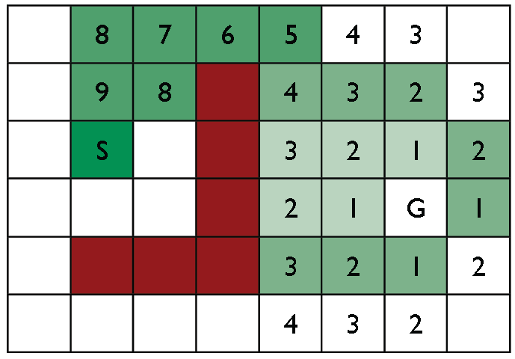
Now we get the accurate heuristic of N expanded nodes from initial to goal

Slide 6
After we get the accurate heuristic of N expanded nodes from initial to goal, each agent can do CA* on its’ own expanded nodes.
If there are other agent on the path to the goal, RRA* will be resumed to expanded more nodes until a new shortest path to the goal has been computed.

Slide 7
A
e1
B
e3
e2
C

